Slide 1
EXHIBIT · 001
THE BRIEF
[YOUR FIRM] · ESTABLISHED [YEAR]
Invest in real assets, earn real yield.
[YOUR FIRM]
C A P I T A L
A private lending firm originating short-term, first-lien mortgages secured by residential and small-balance commercial real estate.
Private Lending · First Lien
DOCUMENT INVESTOR CAPITAL BRIEF
PREPARED BY [FOUNDER NAME], CEO
DISTRIBUTION CONFIDENTIAL / ACCREDITED
YEAR 2026
YOURFIRM.COM
+1 (XXX) XXX-XXXX

Slide 2
[YOUR FIRM]
THE FIRM
02 / 17
AT A GLANCE
A disciplined lender, writing first-lien notes against value-add real estate.
TARGET INVESTOR YIELD
LOANS ORIGINATED
PRINCIPAL LOST TO DEFAULT
9–11%
[XX]loans
$0
Net annualized return distributed quarterly, paid at completion of each loan.
$[XX]M cumulative principal deployed since inception.
Zero investor principal lost to date. <1% borrower default rate.
POSITION
MAXIMUM LTV
LOAN TERM
1st
80%
6–12months
First-lien only. Every note is secured by recorded mortgage or deed of trust.
Capped against the property’s After-Repair Value (ARV).
Short-duration bridge structure with predictable capital recycling.
[YOUR FIRM] — INVESTOR BRIEF [YEAR]
YOURFIRM.COM

Slide 3
[YOUR FIRM]
THE FIRM
03 / 17
ABOUT US
A private lender for the deals banks won’t touch.
WHAT WE ARE
Operator-led. Conservatively underwritten. Skin-in-the-game.
BORROWERS
Experienced fix-and-flip operators, builders, and small developers in our core markets.
We are a private mortgage fund originating short-term, first-lien bridge loans to real estate investors and developers acquiring and rehabilitating residential and small-balance commercial properties.
COLLATERAL
Single-family, multifamily, land, and small commercial — recorded first-lien on every note.
COUPON
Loans priced at 14% interest to borrower; 9–11% net annualized return to investors.
We exist where traditional banks can’t move — on deferred-maintenance assets, on compressed timelines, with operator-led underwriting.
[YOUR FIRM] — INVESTOR BRIEF [YEAR]
03 · ABOUT

Slide 4
[YOUR FIRM]
THE OPERATOR
04 / 17
THE OPERATOR
10 years in the dirt before lending a single dollar.
2016
Began acquiring long-term rental properties. Built a portfolio of [XX] buildings totaling [XX]+ units .
2018
Pivoted to fix-and-flip. Completed [XX]+ single-family, multifamily, and commercial projects across multiple states.
OPERATOR
[Founder Name]
OWNER · CEO
2022
Founded [Your Firm] ; transitioned operations to private lending against the same asset class spent a decade rehabilitating.
“I’ve underwritten these deals from the borrower’s side of the table for [X] years. That’s the lens I use to write checks.”
[YOUR FIRM] — INVESTOR BRIEF [YEAR]
04 · OPERATOR
— [FOUNDER NAME], CEO

Slide 5
[YOUR FIRM]
THE OPPORTUNITY
05 / 17
THE OPPORTUNITY
Banks can’t move fast enough on the deals that matter most.
01 Projects
02 Financing
03 Timeline
04 Outcome
Most projects need construction.
Banks won’t touch deferred maintenance.
30+ day closings.
Investor loses the deal.
When a bank can move forward, appraisals, inspections, and slow underwriting still take a month or more.
An all-cash buyer closes in seven days. The original investor — and their financing — miss the window entirely.
Nearly every value-add real estate transaction has a renovation or capex component required to unlock the upside.
Distressed condition fails appraisal and inspection standards before underwriting even begins.
A gap that institutional capital structurally cannot fill.
SOURCE
Internal origination data, [Year]–[Year]
[YOUR FIRM] — INVESTOR BRIEF [YEAR]
05 · OPPORTUNITY

Slide 6
[YOUR FIRM]
THE SOLUTION
06 / 17
THE SOLUTION
We close in days, not months — and we’re backed by the dirt.
i Underwriting
ii Capital
iii Velocity
iv Security
Fast underwriting.
Flexible capital.
Good as cash.
Safe for investors.
Our market knowledge lets us value a property in minutes — no appraisal required. Decisions in days.
We’re not backed by institutional capital. We lend on the merits of each deal, on our own guidelines.
Borrowers make “cash offers” with confidence — our funds are never contingent on bank approval.
Every loan is backed by physical real estate in first-lien position. On default, we foreclose and take title.
The result: borrowers win the deal. Investors get yield. Capital stays anchored to tangible collateral.
A FOUR-PART ADVANTAGE
[YOUR FIRM] — INVESTOR BRIEF [YEAR]
06 · SOLUTION

Slide 7
[YOUR FIRM]
HOW IT WORKS
07 / 17
HOW IT WORKS · PRIVATE MORTGAGE NOTES
Your capital, secured by a recorded lien on a specific property.
STEP 01
STEP 02
STEP 03
STEP 04
STEP 05
i.
ii.
iii.
iv.
v.
Investor commits capital
We originate
Lien recorded
Project completes
Yield distributed
Minimum $50,000. Funds held in escrow until matched with a vetted loan opportunity.
We underwrite the property, the borrower, and the exit. We invest alongside on every loan.
Investor receives a fractional interest in the note, secured by recorded mortgage or deed of trust.
Borrower sells or refinances within 6–12 months. Loan is paid off in full, with interest.
Interest paid at completion of each project. Principal is recycled into new loans or returned on request.
SKIN IN THE GAME
EQUITY BUFFER
LIQUIDITY
We invest in every loan alongside investors.
Most projects carry a minimum of 20% equity below the lien.
Principal recycles in 6–12 months , or returns on request.
[YOUR FIRM] — INVESTOR BRIEF [YEAR]
07 · MECHANICS

Slide 8
[YOUR FIRM]
LOAN TERMS
08 / 17
UNDERWRITING BOX
The shape of a typical loan.
LOAN-TO-VALUE
No more than 80% of the property’s After-Repair Value (ARV).
LOAN SIZE
Average $175K–$200K per loan.
LOAN TERM
6-month base term, extendable to a maximum of 12 months.
LIEN POSITION
First lien only. Recorded mortgage or deed of trust on every note.
COUPON
14% interest to borrower — producing 9–11% net annualized return to investors.
PROPERTY TYPE
Residential single-family, multifamily, land, and small-balance commercial.
EXHIBIT · 002
Every loan we originate must fit inside this box, without exception.
RISK TOLERANCE
Fund a project in its entirety, or co-invest with other investors to diversify further.
[YOUR FIRM] — INVESTOR BRIEF [YEAR]
08 · LOAN TERMS

Slide 9
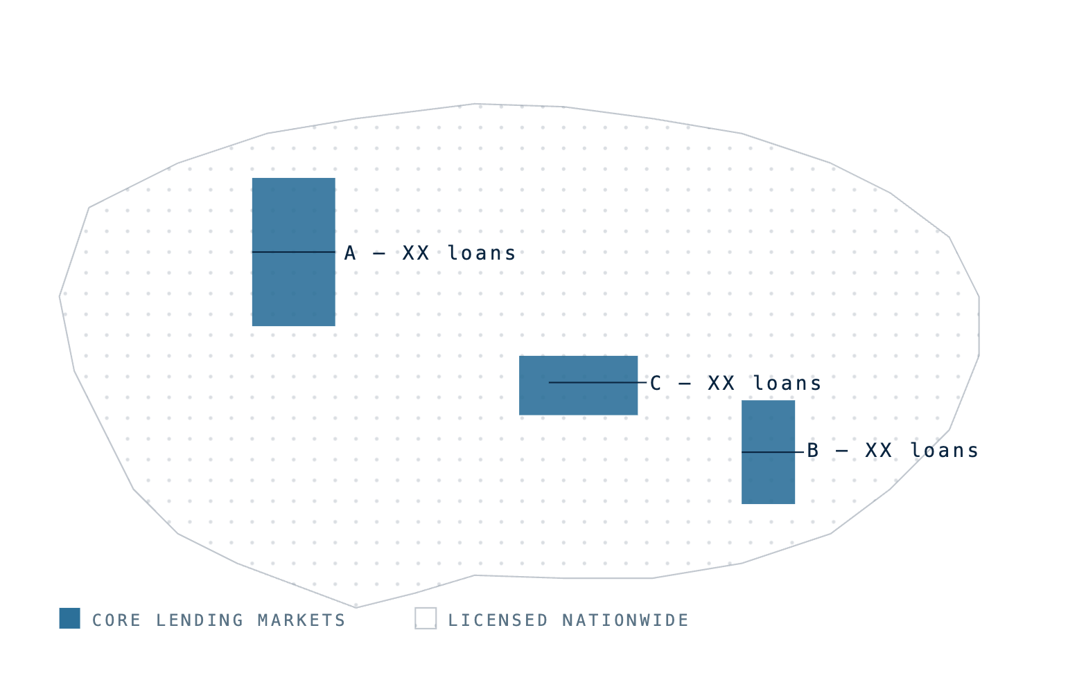
[YOUR FIRM]
MARKET FOCUS
09 / 17
MARKET FOCUS
EXHIBIT · 003
Geographic distribution
Core markets. Boots on the ground.
We can lend nationwide, but 90% of our portfolio sits in core markets where we operate — not where we speculate.
CORE MARKET
CORE MARKET
CORE MARKET
Market A
Market B
Market C
HQ
OPS
OPS
WHY THESE MARKETS
LEGAL POSTURE
Accurate valuation — we know the streets, the contractors, and the comps.
Lender-friendly jurisdictions produce more favorable judgments on default.
[YOUR FIRM] — INVESTOR BRIEF [YEAR]
09 · MARKETS

Slide 10
[YOUR FIRM]
TRACK RECORD
10 / 17
TRACK RECORD · [YEAR] — [YEAR]
EXHIBIT · 004
As of Q1 2026
[X] years. Zero principal lost.
PAST LOANS
ACTIVE LOANS
PROJECTED · 2026
[XX]
[XX]
[XXX]
Completed loans since inception, with a total cumulative balance of $[XX]M originated.
Currently active loans across the portfolio, with $[X.X]M outstanding principal.
Projected total loans for the calendar year — pacing [XX]% above prior-year volume.
DEFAULT RATE
INVESTOR PRINCIPAL LOST
AVERAGE TERM TO PAYOFF
< 1%
$0 to date
[X.X] months
Across the entire portfolio since inception.
Zero capital lost via default or otherwise.
Loans typically pay off well inside the 12-month max.
[YOUR FIRM] — INVESTOR BRIEF [YEAR]
10 · TRACK RECORD

Slide 11
Before
CASE STUDY · 01
[MARKET A]
Hoarder property, cash close in 4 months.
A repeat borrower sought $290K to acquire a distressed property worth $590K renovated. They brought $70K cash and a credible rehab plan. We closed in 11 days.
After
PURCHASE PRICE
AFTER-REPAIR VALUE
$360,000
$590,000
LOAN AMOUNT
LTV
$290,000
80%
TERM
DOWN PAYMENT + REHAB
6 mo. (completed in 4)
$70K + $45K borrower
INVESTOR PROFIT
BORROWER PROFIT
$13,348 (12% net)
~$134,000
11 · CASE STUDY 01
[MARKET A]

Slide 12
Before
CASE STUDY · 02
[MARKET A]
Distressed asset, structured rehab draws.
Borrower acquired a distressed property at $150K (as-is value $180K, ARV $315K). Equity spread let us extend a $140K acquisition loan plus $40K in rehab paid as inspected draws. Sold in 10 months.
After
PURCHASE PRICE
AFTER-REPAIR VALUE
$150,000
$315,000
LOAN AMOUNT
LTV
$140K + $40K draws
77%
TERM
DOWN PAYMENT + REHAB
12 mo. (completed in 10)
$10K + $20K borrower
INVESTOR PROFIT
BORROWER PROFIT
$20,712 (12% net)
~$65,000
12 · CASE STUDY 02
[MARKET A]

Slide 13
Before
CASE STUDY · 03
TEAR-DOWN + NEW BUILD
Land-up rebuild, 56% LTV at completion.
Borrower owned the lot free-and-clear with a $50K shop on the rear. We financed the tear-down and ground-up build at an all-in cost of $160K. Refinance appraisal: $285K. The new home now operates as a short-term rental.
After
ALL-IN COST
AFTER-REPAIR VALUE
$160,000
$285,000
LOAN AMOUNT
LTV
$160,000
56%
TERM
EXIT
12 mo. (completed in 9)
Refinance at completion
INVESTOR PROFIT
BORROWER PROFIT
$14,203 (12% net)
~$82,300
13 · CASE STUDY 03
TEAR-DOWN + REBUILD

Slide 14
[YOUR FIRM]
RISK & SAFEGUARDS
14 / 17
RISK & SAFEGUARDS
EXHIBIT · 005
What can go wrong — and how we protect you when it does.
Default waterfall
LAYERED DOWNSIDE PROTECTION
TRACK RECORD · DEFAULT SCENARIO
i.
Borrower defaults — we negotiate.
<1%
$0
Often, We can remedy default directly with the borrower without filing — avoiding legal fees and recovering principal faster.
ii.
Negotiation fails — we foreclose.
OF ALL LOANS DEFAULT
INVESTOR PRINCIPAL LOST
Our first-lien position lets us foreclose and take the property as collateral. We lend in lender-friendly states to accelerate this.
iii.
Property recovered — we resell.
We operate as a real estate firm. We can rehabilitate and resell recovered collateral in-house at our cost basis.
INVESTOR CANDOR
iv.
Equity buffer absorbs shock.
Private lending is not risk-free. Real estate values can fall, borrowers can fail, and foreclosure timelines vary by state. We mitigate — we don’t eliminate.
Loans are capped at 80% of ARV with most projects carrying 20%+ equity below the lien — the cushion that absorbs any value decline.
[YOUR FIRM] — INVESTOR BRIEF [YEAR]
14 · RISK

Slide 15
[YOUR FIRM]
INVESTOR CONSIDERATIONS
15 / 17
INVESTOR CONSIDERATIONS
An honest look at both sides.
PROS · WHY THIS WORKS
RISKS · WHAT TO WATCH
+
Asset-backed yield.
−
Real estate market risk.
Every dollar is secured by a recorded lien on a specific property — not a balance sheet, not a brand.
A sharp decline in local home values would compress the equity buffer that protects your lien.
+
Short duration.
−
Borrower execution risk.
6–12 month notes mean capital recycles quickly. You’re never locked into a multi-year LP commitment.
Construction overruns, contractor delays, or unexpected scope can stretch a 6-month loan past 12.
+
Operator alignment.
−
Liquidity is loan-bound.
The firm invests its own capital in every loan, in pro-rata first-lien position alongside investors.
Capital is committed for the life of each note. Early withdrawal isn’t available mid-loan.
+
Uncorrelated income.
−
Foreclosure friction.
Coupon yield from physical real estate — not tied to public equity volatility or interest-rate sentiment.
Even in lender-friendly states, taking back collateral takes time and legal cost in a worst-case scenario.
[YOUR FIRM] — INVESTOR BRIEF [YEAR]
15 · CONSIDERATIONS

Slide 16
[YOUR FIRM]
THE ASK
16 / 17
IN SUMMARY
An alternative to the stock market — anchored to real property.
We are actively raising additional investor capital to expand origination volume. Our conservative underwriting, first-lien-only mandate, and operator-led process offer a profitable opportunity with minimal risk — outside the stock market.
RETURNS BENCHMARK · REPRESENTATIVE RANGES
[Your Firm]
9–11%
FIRST-LIEN NOTES
S&P 500
~10%
LONG-TERM HISTORICAL
10-Yr Treasury
~4.3%
2026 SPOT
High-Yield Savings
~4.5%
TOP-TIER APY
[YOUR FIRM] — INVESTOR BRIEF [YEAR]
16 · SUMMARY
COMPARISON SHOWN FOR CONTEXT. S&P AND TREASURY YIELDS CARRY MATERIALLY DIFFERENT RISK AND LIQUIDITY PROFILES. PAST PERFORMANCE IS NOT INDICATIVE OF FUTURE RESULTS.

Slide 17
PRIMARY CONTACT
[Founder Name]
[YOUR FIRM] · ESTABLISHED [YEAR]
OWNER · CEO
NEXT STEPS
Let’s talk.
+1 (XXX) XXX-XXXX
PHONE
EMAIL
contact@yourfirm.com
We’d be glad to walk through current loan opportunities, send recent investor statements, or schedule a call to answer specific questions.
WEB
yourfirm.com/invest
Conservatively underwritten. Operator-led. Skin in the game.
MINIMUM INVESTMENT
$50,000
— OUR STANDARD

